Slide 1

Genome Editing in Japan: A Bioethical Perspective
Second International Summit on Human Genome Editing
Session: Social and Philosophical Reflections on Manipulating Genetic Variation
Satoshi Kodama
Kyoto University, Japan

Slide 2
Aim of the talk
Explain Japan’s regulatory framework concerning genome editing in human embryos
Discuss the important considerations for future discussions in Japan and beyond

Slide 3
Outline
The Draft Guidelines on Research involving the Use of Gene Editing Tools in Human Embryos
The Experts Panel on Bioethics and research using human embryos
Discussion

Slide 4
Word of caution
Not representing Japan nor any organisation

Slide 5
1. The Draft Guidelines on Research involving the Use of GETs in Human Embryos

Slide 6
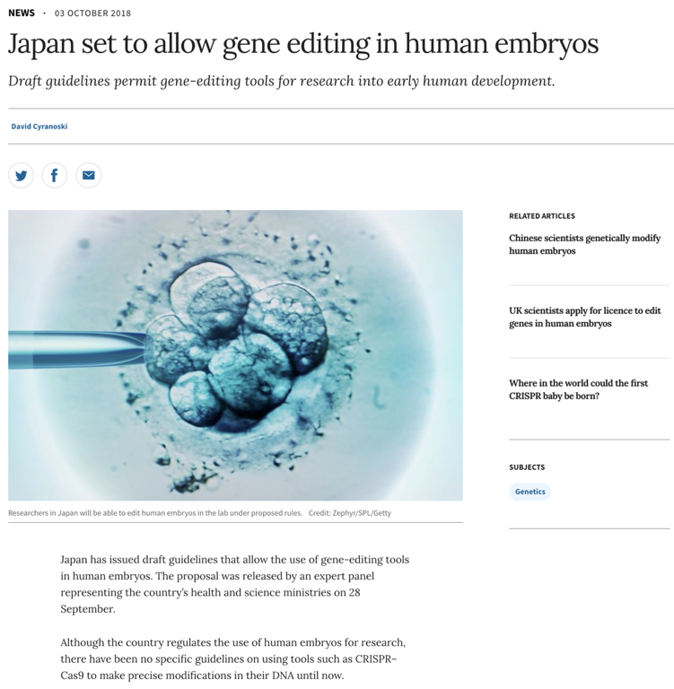
The guidelines will ALLOW:
- BASIC research using GETs,
- using SPARE embryos,
- for improvement of ART
It will NOT ALLOW:
- basic research for the treatment of genetic and other diseases
- CLINICAL application
Nature, 03 Oct 2018

Slide 7
2. The Expert Panel on Bioethics and research using human embryos

Slide 8
The Expert Panel on Bioethics

Slide 9

1. Basic Principles concerning the Handling of Human Embryos 2004
- human embryos = “sprouts of human life”
- need protection to maintain human dignity
- research use is exceptional but allowed on conditions of 1)scientific validity, 2)assurance of safety, and 3)social validity

Slide 10
2. 2016 Expert Panel’s Interim Report on Using GETs in Human Embryos
Basic Research using GETs: Conditionally OK
Applied the Basic Principles
Approved research of development and differentiation of embryos
But not other types of research
No new creation of human embryos for research

Slide 11
3. 2017 Task Force’s First Report to Review the Basic Principles
No revision of the principles
Recommendation to create the guidelines on research involving the use of GETs in human embryos
⇒The 2018 draft guidelines

Slide 12
The Discussion of the Expert Panel
2004 Basic Principles on the Handling of Human Embryos | Embryo = Sprout of Human Life Research Use is Exceptional but allowed on conditions of 1)scientific validity, 2)safety, 3)social validity
2016 Expert Panel’s Interim Report on Using GETs on Human Embryos | Basic Research: Conditionally OK Clinical Application: Impermissible
2017 Task Force’s First Report to Review the Basic Principles | No revision of the Basic Principles Mandated Creation of the Guidelines
2018 Draft Guidelines on Research involving the use of GETs in Human Embryos | Limited to BASIC Research For Improvement of ART Using SPARE Embryos

Slide 13
3. Discussion

Slide 14
1. The Basic Principles Approach
Applying the principles to the types of research
Piecemeal
Consistent

Slide 15
1. The Basic Principles Approach (Cont.)
Limitation of Scope
Silent on germline cells such as sperm and eggs
Not clear whether such research would undermine human dignity
Silent on the Clinical Application
The interim report is against the clinical application, but the reasons were not derived from the Basic Principles
⇒Needs a major revamp

Slide 16
2. Need for more democracy in policymaking
Tendency to avoid legislation
Legislation is desirable for more public discussion
Not doing bioethics incognito

Slide 17
3. Apparent absence of religion
No mention of Buddhism or Confucianism
Human dignity not associated with Christianity
More democratic discussion may bring forth diverse perspectives including religion

Slide 18
2. 2016 Experts Panel’s Interim Report on Using GETs in Human Embryos
Clinical Application: Impermissible
1) the risks of off-target mutations and mosaicism
2) unpredictability of the effects of genetic modification on other genes
3) the risk of harmful effects of genetic modification on off-springs
4) the totality of human gene pool is a precious inheritance from past generations; rather than decreasing that totality by genetically modifying the human embryos with genetic diseases, society should be more accommodating to these vulnerable people

Slide 19
Thank you for listening
Email: kodama.satoshi.4v@kyoto-u.ac.jp

